Slide 1
Geography summer task
Please work your way through the following PowerPoint.
→The PowerPoint has been split up into 4 weeks worth of work for you to manage your time well
→You will notice that there are info slides and example slides. Please type your own work into a word document
→Once you have completed it, please email it to Mr Vernon evernon@toothillschool.co.uk and Miss Hale khale@toothillschool.co.uk
→If you have any questions, please get in contact with Miss Hale ☺

Slide 2
INFO: A-Level Geography
Conducting a virtual investigation
At A-level, you will have to complete an individual investigation in the field. The individual investigation must be based on a question or issue relating to any part of the specification content taught.
During this project, you will be practicing these skills by completing a virtual investigation in preparation for completing your own chosen project in Year 12.
Please use a word document to write your own work on and use the information slides and example slides to help.
Key Geographical Assessment Objectives (AO) to be covered in pursuit of this project:
AO1: Demonstrate knowledge and understanding of places, environments, concepts, processes, interactions and change, at a variety of scales
AO2: Apply knowledge and understanding in different contexts to interpret, analyse and evaluate geographical information and issues
AO3: Use a variety of relevant quantitative, qualitative and fieldwork skills to investigate geographical questions and issues, interpret, analyse and evaluate data and evidence and construct arguments and draw conclusions

Slide 3
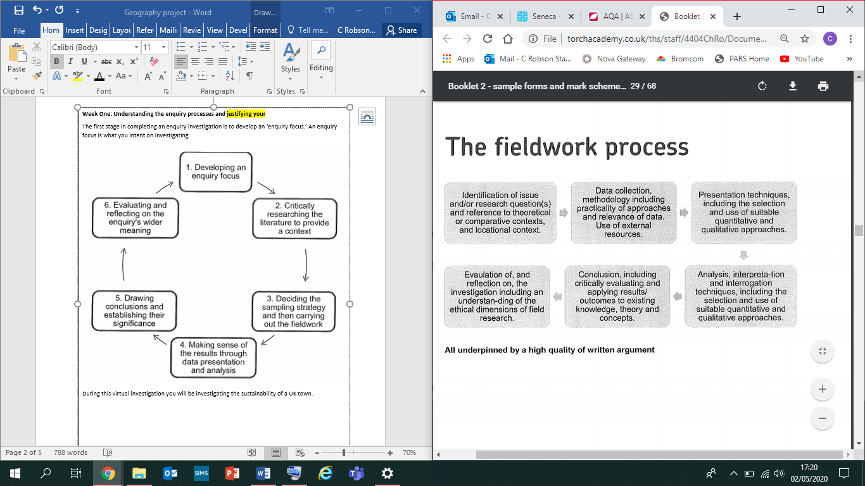
INFO - Enquiry process
Over the next 4 weeks, you will be set a assignments to complete which will take you through how to conduct and complete a Geographical enquiry step by step.
Week 1 – tasks 1 -5 – locational context
Week 2 – tasks 6 and 7 – collecting your data
Week 3 – tasks 8 - 10 present data and analyse the patterns shown.
Week 4 – tasks 11-12 conclude the findings to your investigation and evaluate the investigation process

Slide 4
Week 1 – INFO - identify and justify your research topic as well as locational context

Slide 5
Step 1 - Title
You will be completing a research project in your local area (area x)
‘Is Area X a sustainable town?’ is going to be your title.
Task 1 -> put the title at the top of the word document, inserting the name of your local area.
Task 2 - > Define the term sustainability.
Notes:
What is sustainability?
https://www.bbc.co.uk/bitesize/guides/zqvxdmn/revision/1
https://www.sciencedirect.com/topics/social-sciences/brundtland-report

Slide 6
Step 2: Breaking down your investigation question into hypothesis
A hypothesis is a testable statement that you predict will be the outcome of your study.
The hypothesis you will be investigating is:
The quality of the environment in the centre of town X is lower than the outskirts
Task 3 – in you word document you need to explain your answers to the following questions in a paragraph for your hypothesis:
What do you expect to find out in your hypothesis and why? You will need to research your towns environmental quality. You may also wish to research why the outskirts of cities tend to have lower levels environmental quality
How will collecting data for hypothesis help you answer your investigation title? If you find out that the environmental quality is high, what does that tell you about sustainability in the city?

Slide 7
Step 3: Locational context
Please see example on the next slide
Task 4 - On your word document you now you need to display where you will collect your data and describe the location of Area X on 3 scales:
National – where Area X is in the UK
Regional – where Area X is in relation to county
Local – where your data collected sites are in the town of Area X
Use this example to aid your locational context description of X. You must be saying why you picked X as a good place to investigate sustainability. Here you will need to think about whether sustainability levels are high or low here as well as other benefits of this location.
Task 5 – describe the locational context (importance) of visiting your town / area to investigate whether it is a sustainable city using the maps given.

Slide 8
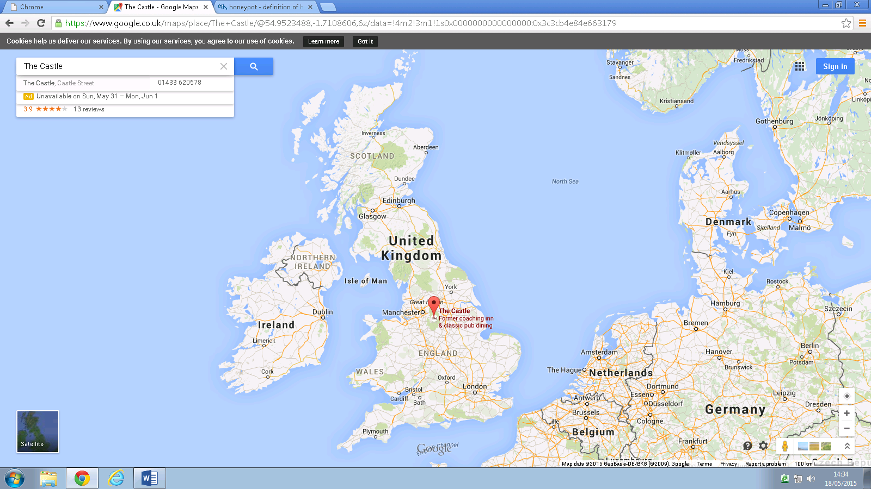

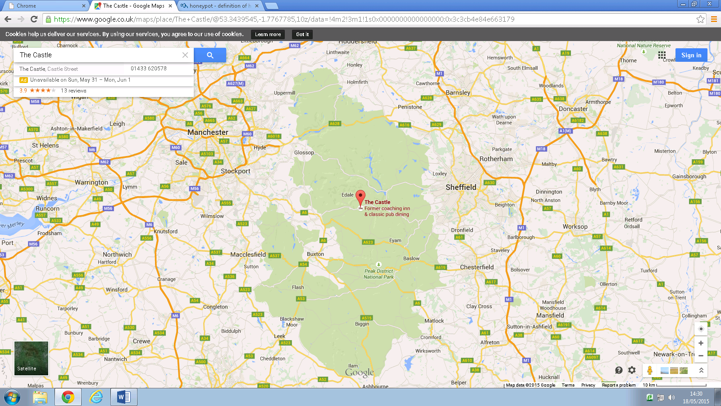
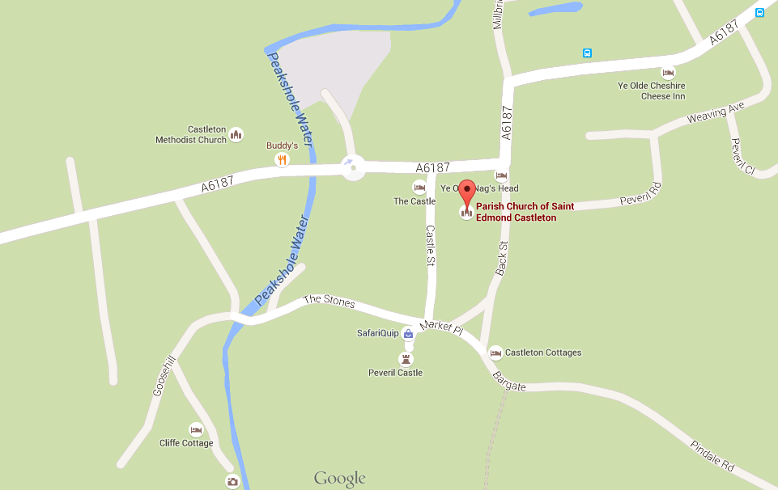
Example - Locational context - Castleton
This is a regional map of Castleton. It has many surrounding villages such as Buxton and Matlock.
From this map I can see that Castleton is located in the middle of the Peak District National Park.
National map
This is a national map of Castleton.. It is located in the Midlands and is South-East of Manchester.
Regional map
The reason why I chose to visit Castleton is because it is close to school. This means I will be able to collect a large amount of data in a small amount of time. Also there is a field studies centre that we are staying at which means I can borrow any equipment that I need, reducing the cost of my work. In addition, the area is a small honeypot site so it can suffer from the effects of tourism. This can mean that the area lacks sustainable features. This is more true in summer time (the time I am visiting) as it can mean that that more people are travelling to this area which could crate higher levels of air pollution. In addition, the area has been noted by the Peak District Nation Authority to receive high levels of tourists which stimulates local businesses which is good evidence of economic sustainability.
Local map

Slide 9
Week 2 – INFO: write a detailed methodology

Slide 10
INFO: Your investigation title: ‘Is Area X a sustainable town?’
Step 4: Writing a detailed methodology
Task 6
You will need to choose 4 sites in your local area to research this question and answer your sub question/hypothesis
Consider whether you will choose a random, systematic or stratified sampling strategy.
Locate your 4 sites on a map on your word document and justify your sampling strategy.
Help with sampling strategy: https://www.geography-fieldwork.org/a-level/before-starting/methods/sampling/

Slide 11
Methodology
Task 7 - Collect your data. You may need to draw your tables or print them.
Method 1
Environmental Quality:
Date:
Time data collected:
Traffic Type | -2 (very poor quality) | -1 (poor condition) | 0 (average condition) | 1 (good condition) | 2 (very good condition)
Visible litter
Dereliction
Graffiti
Building condition
Green Space
Total Score: Mean Score:
Walk the length of each street. Give a score to each category

Slide 12
Methodology
Method 2
Task 7 – take photos at each site of sustainable features
Name of method: Photographs
Equipment needed: Camera on phone
When, where and why? On each street use opportunistic sampling to take photos of any evidence of sustainability or any evidence of poor sustainability in the street. Upload to this document and annotate to explain the sustainability of the area.

Slide 13
Week 3 – present data and analyse the patterns shown

Slide 14
INFO: Your investigation title: ‘Is X a sustainable town?’
Step 6: Data presentation
Data has to be put into an appropriate graph. It is important when presenting data you consider whether it is continuous data or discrete data, and that you present the data in the right format using this information.
It is also important that you give each graph a summary title, label both axis, include the unit of measurement on your axis and make sure each graph for the same data has the same scale
Task 8 – Present the data in an appropriate graph and make sure it has a title and axis label – you will need to use excel of this.
See prompts on next slide.

Slide 15
EXAMPLE: Presenting data
Task 8 Create a radar graph for each of the 4 sites using this data for your environmental-quality survey:
Site 1 – Outside ‘Opera House Casino
Feature | Environmental quality score
Visible litter | -1
Dereliction | -1
Graffiti | -2
Building condition | 0
Condition of walls/fences | 0
Instructions on how to make a radar graph on excel:
Click ‘Insert’ on the top bar
Click ‘Chart’
Select ‘Radar’ and click ‘Ok’
In column A, change boxes 2-6 to the headings used in the table above. E.g. in box 2A type ‘Visible litter’
In column B, change box one to ‘Environmental quality score and boxes 2-6 to the numbers shown above e.g. -1 in box 2B
Delete column C (click on ‘C,’ right click and then select ‘delete’)
Your radar chart should now be complete. Click on the ‘x’ in the top right corner of the excel tab
Now double click on the numbers in the middle of the radar graph
Select ‘Axis options’ and alter the following:
  Minimum = -2.0
  Maximum = 2.0
  Major = 1.0
Click enter and the numbers should now go up in ones from -2 to +2
Click on the title and alter it to a relevant title (see the example I have made to name the next 3 graphs you produce)

Slide 16
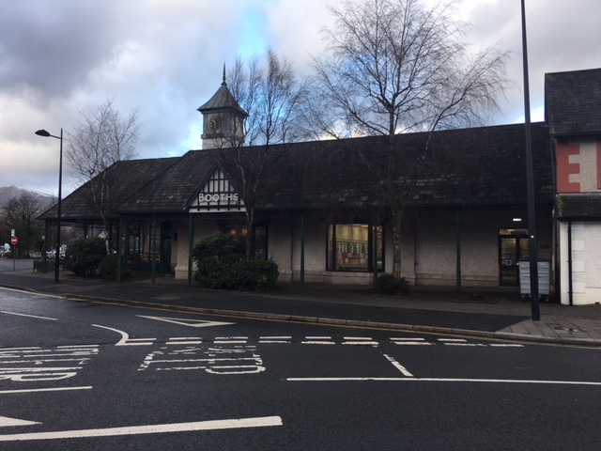
INFO: Your investigation title: ‘Is X a sustainable town?’
Step 6: Data presentation
Annotating photographs is using qualitative data. It is important to explain your annotations and draw an arrow to the feature you are analysing. Top level work with triangulate this data with other data sets to affirm validity of their analysis and critique the reliability of their work.
Task 9 – Annotate the 2 photographs you took. Make sure your labels link to your hypothesis
Hypothesis - The quality of the environment in the centre of X is lower than the outskirts
The outside of the building is well maintained. This could attract more tourists boosting the local economy via the multiplier effect meaning economically it is more sustainable. However, close to the bushes and around the edges of the building, there was a lot of chewing gum and cigarette butts left lying around on the floor despite the fact there was a bin, so an effort has been made to try and reduce this problem.
Busy area, usually very congested road outside a convenience store. This is bad because it means that the gases released from the vehicles contribute to global warming and increase greenhouse gases in the atmosphere. It also has a negative effect on the immediate environment and shows sustainability levels are lower here.
No graffiti at all and the appearance of each business is neat and clean. This is good for the environment as it makes the area more appealing and increases the quality of the environment in this area.

Slide 17
INFO: Your investigation title: ‘Is X a sustainable town?’
Step 7: Analysing the data
You now need to analyse each graph you have produced. Here is the structure of what to include in each analysis paragraph:
Trend – what is the overall pattern or overall picture? Refer to graph number you are talking about in your description. Make sure you include data which you can manipulate.
Explain reasons for data – does it answer hypothesis? What does the data suggest?
Describe how accurate this data is likely to be – were there any limitations? Is your data representative or only relevant to one area?
Task 10 – Write an analysis for each graph (there is an example on the next slide to help you)

Slide 18
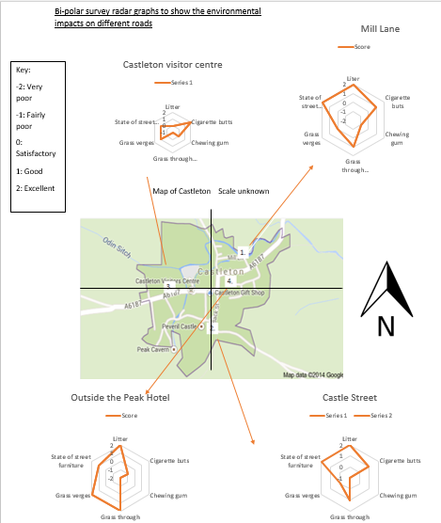
EXAMPLE: data analysis of EQS
“From this radar graphs I can see the overall pattern is that the environmental quality at this are is quite good. This might be because the location is close to the visitor centre so the local council make a large effort to keep the area attractive to entice more tourists here to spend more money or repeat visits. best environmental category was cigarette butts with a score of 2. I think that this is because the visitor centre will have workers to pick them up after the tourists have left them on the ground. This is to create a good impression of Castleton to encourage people to come back again and increase its revenue as a town as it is heavily economically dependent on tourists. This demonstrates the positive environmental impacts that tourism has on the area. The worst environmental category with a score of -1 was the grass through the pavement. I think that this is because it is hard to remove so it has just been left and built up over time. The second worst environmental category with a score of 0 was chewing gum. I think that this is because it is left behind by the tourists and over time has been trodden into the ground making it very hard to be removed, so there isn’t much that the visitor centre can do to get rid of it so it remains there. The second best environmental categories were the state of street furniture and grass verges as these are also clearly looked after by the visitor centre workers to give off a good impression of the area. However, it could be argued that my data is not reliable as it is subjective and based on my own opinions of one day of the year. I did collect data with a friend and took the average of our opinions to make my data more reliable.

Slide 19
Week 4 – conclude the findings to your investigation and evaluate the investigation process

Slide 20
INFO: Your investigation title: ‘Is X a sustainable town?’
Step 8: Writing conclusions
You now need to conclude your findings for this investigation. The best way to do this is conclude each hypothesis and then conclude your title question:
Hypothesis - The quality of the environment in the centre of X is lower than the outskirts
Title question - Is X a sustainable town?’
To write a conclusion you need to include the following:
Patterns and data from your graph(s)
Explain what the data shows in relation to your sub question and your title; what does it tell you about your town?
You must think about how reliable your results are. Can you trust them? Are they valid? Why? How could this impact your conclusion?
When doing your overall conclusions, you need to weigh up your sub question to then state whether your town is sustainable or not. Is it for some aspects but not all? Is this conclusion therefore valid?
Task 11– Write your 2 conclusions (two concluding your hypothesis and then an overall answer to your title question) – see example on the next slide

Slide 21
Example conclusion for example data analysis
“I think that overall tourism has had a negative environmental effect on the area, but this is not true of all areas. This is because when tourists come they don’t bother to put their litter into the bins provided, some just leave it on the floor. For example Castle Street had a lot of chewing gum that had been trodden into the ground (score of -1 on the radar graph). This can lead to the deprivation of plant growth and also if an animal were to eat the chewing gum they could die. In addition to this there were quite a few cigarette butts outside the Peak Hotel (score of -1 of the radar graph). This is bad for the environment as they are an extreme threat to wildlife. Animals often mistake cigarette butts for food and swallow them, this can have very damaging internal effects for the animals. In addition to this cigarette butts aren’t biodegradable and can take many years to decompose. However tourists can have a positive impact on the environment as they force people who live and work in Castleton to take care of the litter and the environment, for example outside Castleton’s visitor centre there was virtually no cigarette butts (score of 2 on the radar graph). This then boosts the economy as more tourists are likely to visit the area if it looks nicer. It is almost like a cycle, more tourists’ means more money can be reinvested into sorting out the environment and scenery which in the long run will then lead to more tourists wanting to visit the area. However outside of the Visitors Centre I did discover a significant amount of chewing gum which could prove that it’s predominantly the tourists that are causing this as this area and building is specifically designed for tourist use. In our questionnaire 4 people said that they think that tourism is good for Castleton as the money spent by tourists can be spent on sorting out the environment. For these reasons I cannot completely say that tourism has had a negative environmental impact on the area as it has had some positive impacts on the area. My conclusion is valid overall as I took an average of my scores with a friend to make them more reliable and there is evidence from my photographs to support my findings. Whilst it could be argued that my results are only reflective of one day of the year that I visited these streets, the environmental quality will largely not differ and it if anything be better another times of the year. This is because I went in the height of summer which is peak tourists time so the environment is likely to be worse due to high volumes of people being there. Overall, I can conclude that tourism does have a negative impact in Castleton and this therefore proves that ”

Slide 22
INFO: Your investigation title: ‘Is X a sustainable town?’
Step 9: Evaluating my investigation
This is where you need to look at how your methods impacted your data collected and how this therefore impacted your conclusions. Are your results reliable? Can they be trusted? Are your conclusions valid?
Say what was good about your environmental quality data method. Why did this mean you collected accurate results? If your results are accurate, does this mean your conclusion is valid (think about scale!)? If it is, state why it is valid.
Say what was bad about your environmental quality data method. Why did your original data collection mean you collected inaccurate results? Why would your improvement mean accurate results? Is your conclusion still valid (think about scale!)? If so, why? If your conclusion is now not valid, why is it not laid and how would your improvement improve the validity of it?
Task 12 – Write an evaluation for your investigation (there is an example on the next slide to help you).

Slide 23
EXAMPLE: evaluation of environmental quality survey (bi-polar)
“One error that occurred in one of my data collection methods would be that our bi-polar survey was very limited as we only sampled four streets in Castleton. For this reason our results may have meant that my graphs and conclusion may not display an accurate representation of the environmental impacts of tourism in Castleton as we only sampled a small percentage of the streets. Only obtaining a small set of results may mean that my graphs show an inaccurate pattern and dos not reflect the environmental impact of tourism across the whole of Castleton. This may also mean that my conclusion is incorrect as it was drawn up from the graph. If we had surveyed more streets this may have meant that, for example, we may have encountered a lot more litter and cigarette butts which would have completely changed our graphs and our opinion on the environmental impacts of tourism on the area. In addition to this my radar graphs all demonstrate that grass through the verges weren’t very common which provides me with an overall positive impression of tourism. However this result may change dramatically if I visited and scored a few other streets. A good way to overcome this problem and to obtain a more accurate set of results would be to return to Castleton and collect data from more roads or even every single road if possible as this would ensure that our data was completely accurate. We would then be able to make a trustworthy judgement of the environmental impacts of tourism in Castleton as we had surveyed the whole of Castleton, rather than just 4 streets. These improvements would make any future conclusions stronger as my data would be more accurate and I could therefore make an overall judgement on the Environmental impacts of tourism in Castleton as my results are currently not valid and thus neither are my graphs or my Environmental impacts conclusion.”

Slide 24
INFO: Your investigation title: ‘Is Area X a sustainable town?’
Step 10: Ethical considerations
This is where you need to think about how ethical you were and if did your investigation again, what you would do to make it more ethical. You need to write a paragraph explaining the following:
State one way you could have made sure your investigation was ethical
State what you might have done which was unethical and why that is an issue. What would you do to prevent this if you were to do this investigation again in the future?
Task 13– Write a paragraph explaining the ethical considerations taken into account in this investigation (there is an example on the next slide to help you).

Slide 25
EXAMPLE: ethical considerations paragraph
“When taking photographs as a part of my data collection, I did not ask for permission from the people who were features. I recognised this as an ethical issue, thus I have ensured that the face of the people present in the photographs, like those on Main Street, are either unrecognisable, or where the features could be determined, I blurred them out. This protects the privacy of those people and prevents an ethical issue. For my questionnaire the ethical issues are limited as I did not record any personal information of the people I asked and I informed them the purpose of the survey, gaining verbal consent that their answers could, anonymously, be used as a part of my research. However, I did not have written consent concerning the storage of the questionnaire answers, which were on a password protected laptop but without a document password, so others within my family could have seen the information. Also, I did not obtain permission to use the data for graphs and data manipulation specifically, thus presenting a slight ethical issue. Whilst walking around Castleton, I ensured that neither myself or my group harmed any of our sites, for example we did not leave any litter. Safety was also ensured by considering the preventative measures laid out in my risk assessment. As I completed a survey, I did interact with the public, so I acted respectfully and if they did not want to complete the survey, I accepted their decision and left. The main ethical consideration is the reliability of my data, to my knowledge, all data recorded here is accurate, contains no misleading information and is a truthful representation of Castleton.”

Slide 26
Investigation complete!

