Slide 1


Welcome to the OCR Cambridge National Level 3 AAQ in Engineering
By the end of this course, you will:
Learn a combination of engineering principles and mathematics
Develop an understanding of health and safety, team-work, effective communication with individuals or groups, interpreting and creating computer-aided engineering drawings
Work through engineering projects to analyse, redesign, model and build prototypes to meet the given briefs

Slide 2
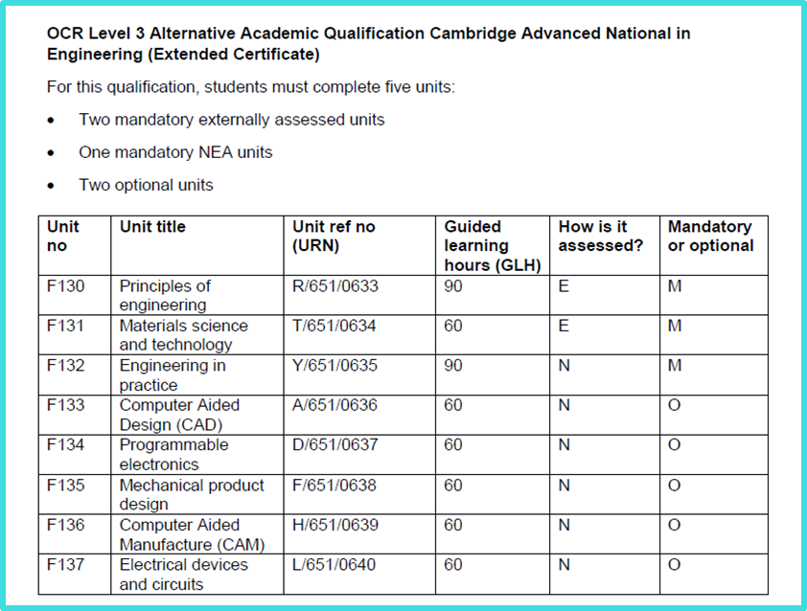
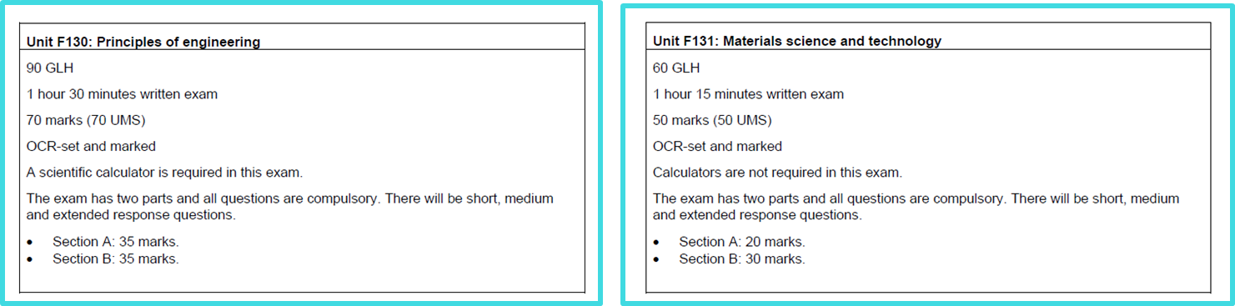
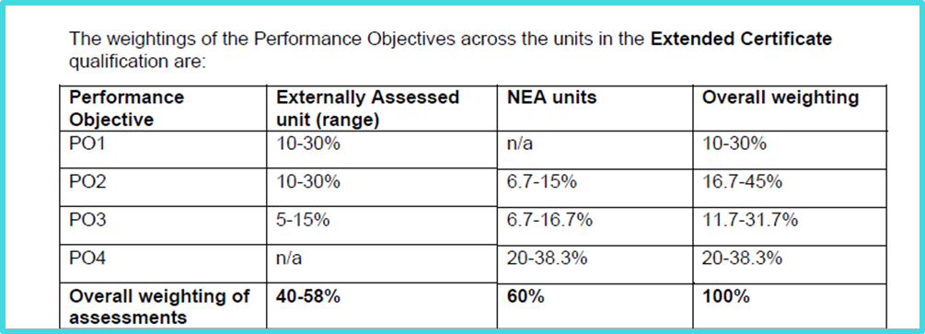
Cambridge National Level 3 in Engineering

Slide 3
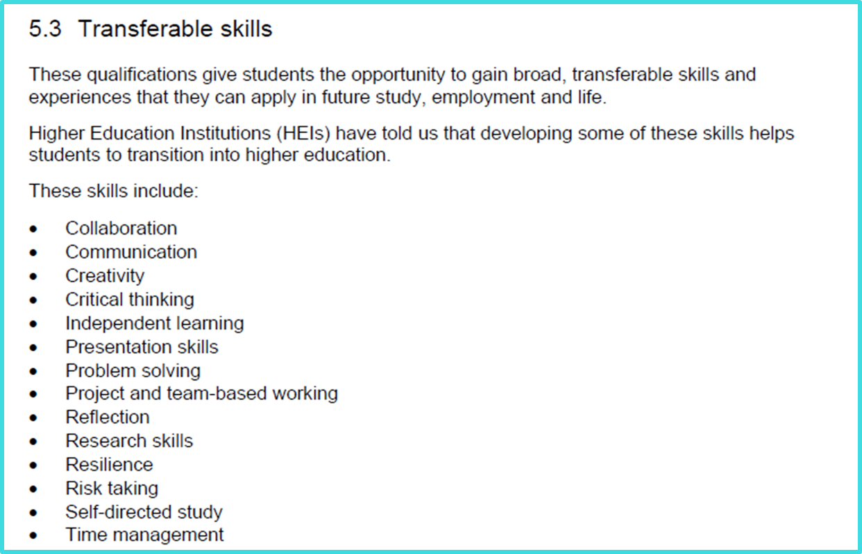
Cambridge National Level 3 in Engineering

Slide 4
Cambridge National Level 3 in Engineering
Requirements
Course requirements
Grades 9–5 in GCSE English, Mathematics and Science, L2P or above in Engineering or equivalent course (Design and Technology)
Which skills are needed?
Numerical and non-numerical data analysis skills Writing skills – annotation, analysis and evaluation skills Mathematical problem solving skills Drawing skills – freehand, 2D and 3D engineering drawing techniques, along with the ability to understand and interpret engineering drawings CAD skills – 2D and 3D CAD software
Expectations and workload
3 internal formal assessments completed per academic year 2 homework assignments completed per week (coursework based, exam practice, mathematical problems) Dedication to working in the department outside of lesson time – students will need to use specialist CAD software to be able to complete coursework assignments High level of independent reading to support classroom learning An intrinsic interest in engineering

Slide 5
Cambridge National Level 3 in Engineering
Further information
Course Performance
This is a brand-new course starting in September 2025 due to changes in performance table guidelines
Example student destination(s)
The qualification is recognised by higher education providers as contributing to meeting admission requirements for many relevant courses in a variety of areas of the engineering sector, for example:
• BEng (Hons) in Engineering
• BEng (Hons) in Electronics Engineering
• BSc (Hons) in Computer Science
• BSc (Hons) in Mathematics.
Department contact details
Miss Beattie
ebeattie@toothillschool.co.uk
Miss Zaffarese
Azaffarese@toothillschool.co.uk

Slide 6
Engineering Induction lesson

Slide 7
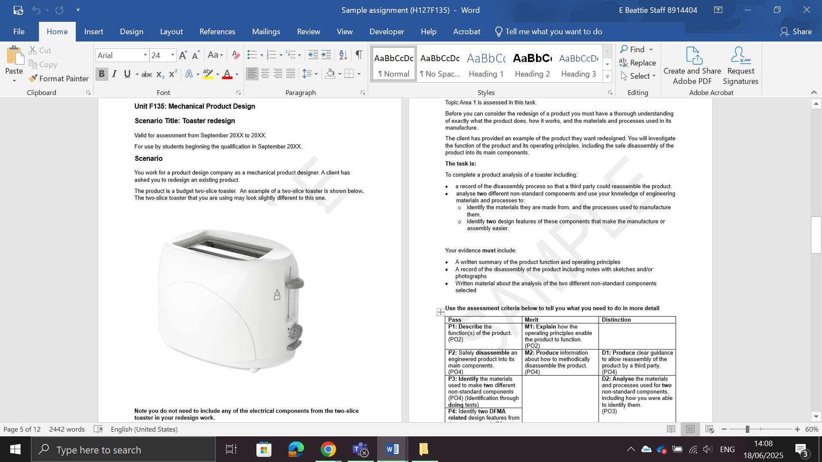
Unit F135 Mechanical Product Design
One of the optional pieces of coursework we will be picking is a product analysis and redesign task like the Level 2 Engineering Design NEAs. It takes the redesign, annotate and justify elements from R039, and the product disassembly and analysis bits from R040 and combines them together.

Slide 8
Unit F135 Mechanical Product Design
Let's begin by analysing the image of the toaster:
What do you think it's made from? Why?
How will it have been made? Why?
What standard components might have been used?
How will it have been put together?
Do you think it's expensive? What are your reasons for your opinion?
What is its function? Do you think it works well?
What are the good points about this design? How do you feel it could be improved?

Slide 9
Unit F135 Mechanical Product Design
Toaster Product Analysis:

Slide 10
Engineering
Summer Task
Notes:
Students will have this as an A4 booklet, they will then add any extra sheets in themselves as they go.

Slide 11
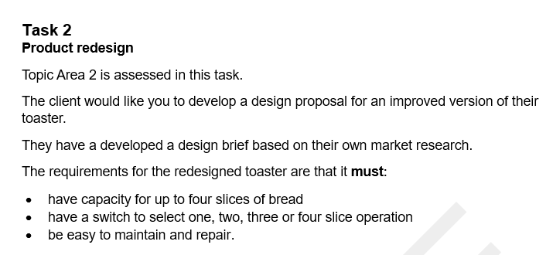
Unit F135 Mechanical Product Design
Task 1: Toaster Mood Board:
On powerpoint, and using the internet you need to gather AT LEAST 20 images of existing toasters, when finding images think about picking ones the meet the scenario and specification points you have been given.

Slide 12
Unit F135 Mechanical Product Design
Task 2: Toaster Redesign:
Using your product analysis notes, mood board and the specification points you need to ccomplete the following tasks:
Create three different design ideas for the toaster redesign, these must meet each requirement set out in the client brief
The ideas must be communicated effectively using annotated freehand sketches which include both 2D and 3D drawing techniques
Your annotations must be detailed and justify how and why your ideas meet or do not meet the requirements set out in the client brief (colour coded text could be used to communicate this)

