Slide 1
UCAS 2026 Application
Right First Time – EDUCATION section

Slide 2
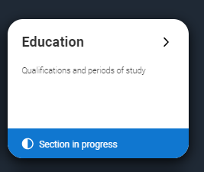
Education
Choose Education on the left hand menu

Slide 3
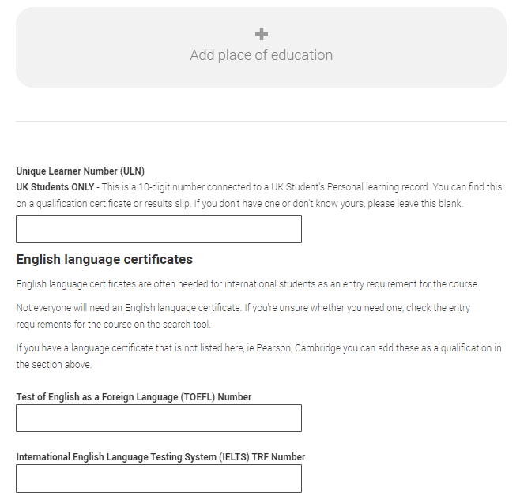
Education
Unique Learner Number
Please ask your tutor for the number.
It is a unique 10 digit value
English language certificates
  These will be left blank
*See Mr. Lawrence if you do have a TOEFL or IELTS award.

Slide 4
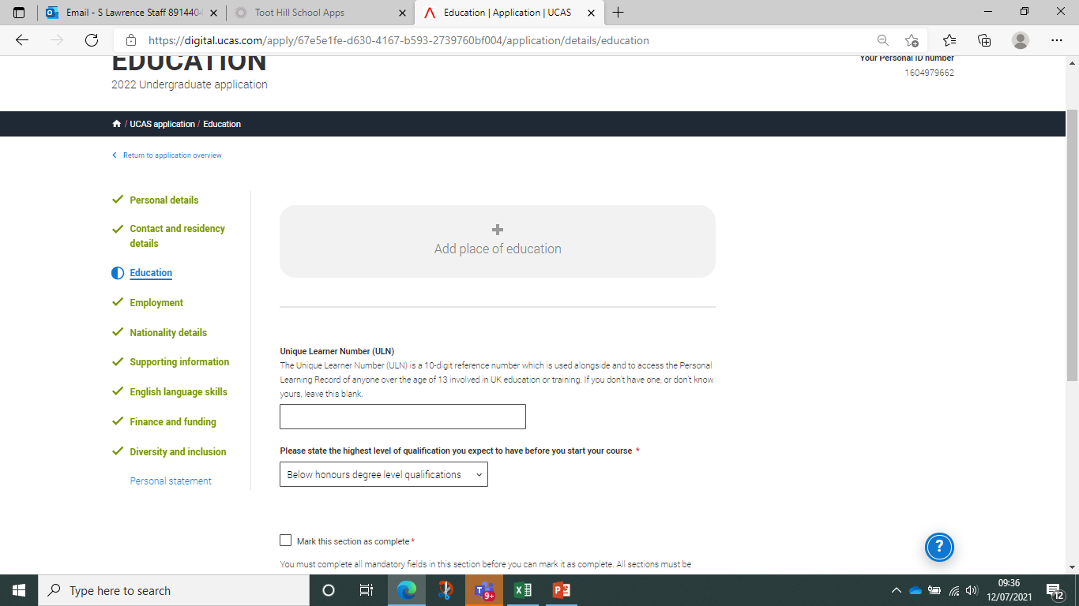
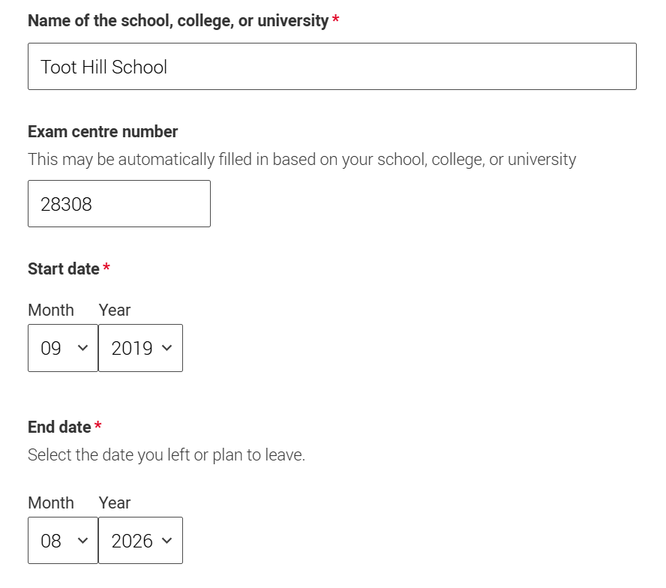
Education
Click on ‘Add place of education’
Should auto select or type ‘Toot’ into the search.
Then select ‘Toot Hill School’
Start date 09/19*
End date 08/26
Type of study – Full Time
Qualifications? - Yes
* Assumes you started in Yr 7

Slide 5
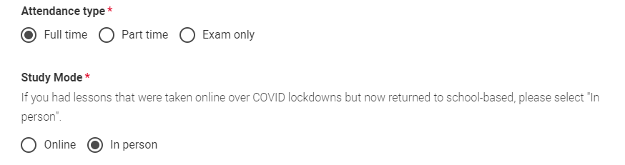
Education
Type of study – Full Time
Study Mode – In Person
Save
IMPORTANT : If you completed your GCSE’s at a different school, then enter this as an additional ‘place of education’ and select dates as appropriate. Repeat the process.
Do NOT enter details of your primary school.

Slide 6
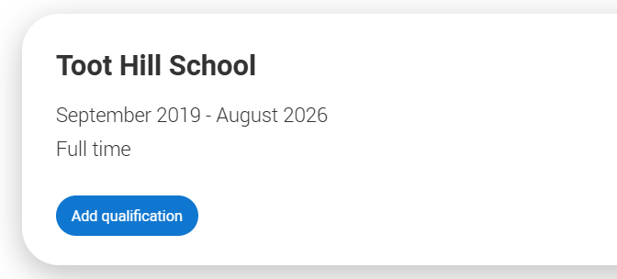
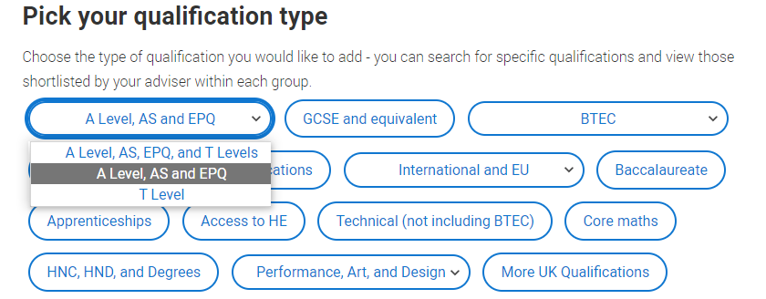
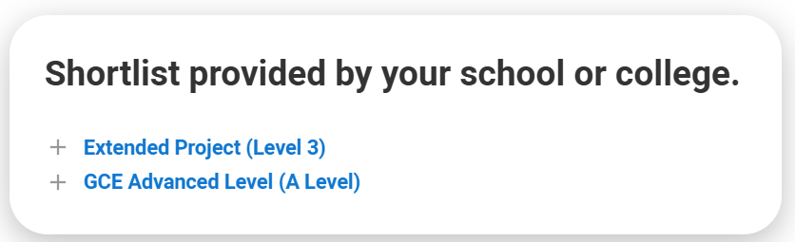
Education – College Subjects
Select ‘add qualifications’
Choose from the qualifications list
Select A Level, AS and EPQ
Choose GCE Advanced Level (A Level)

Slide 7
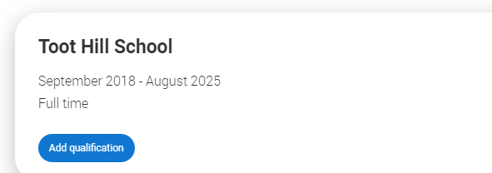
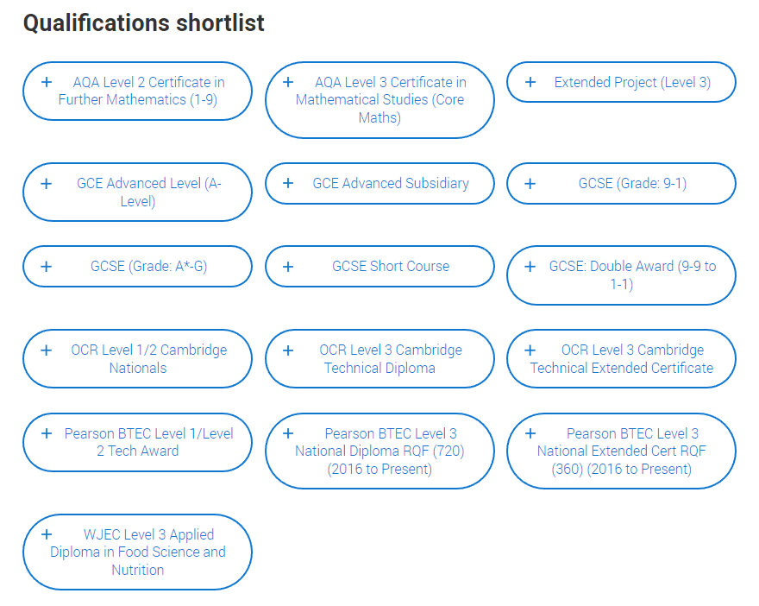
Education – College Subjects
Select ‘add qualifications’
Select from the Popular qualifications list
A level - GCE Advanced
BTEC Double Award - BTEC Nat. Diploma (720)
BTEC Single Award - BTEC Ext. Cert (360)
Business Voc. Double – OCR Tech. Diploma
Business Voc. Single – OCR Tech. Ext. Cert

Slide 8
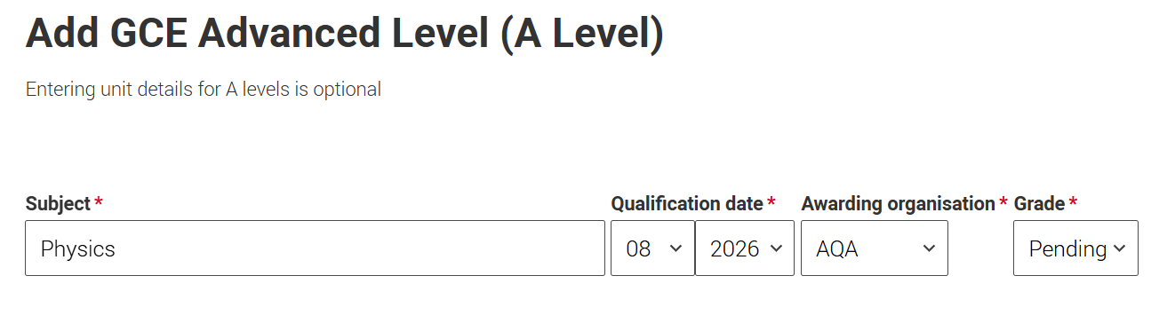
Education – College Subjects
Select ‘subject’ from the drop down list
Select qualification date
as August 2026
Select Exam board
(Check college website if unsure toothillcollege.co.uk/courses.php)
IMPORTANT!! – Select grade as ‘PENDING’
* Do not complete the individual module sections. Scroll to bottom and save.
Repeat to add your next college subject

Slide 9
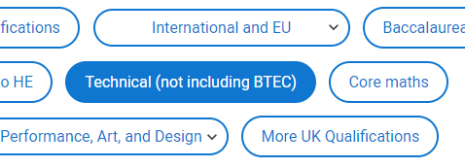
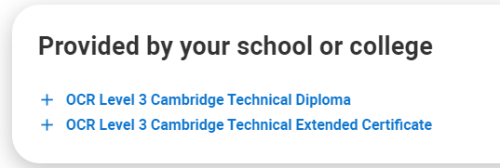
Education - Adding a Technical Vocational Course
Add qualification
Choose from the qualifications list
Select Technical
Double Award : Select Diploma
(Double Business)
Single Award : Select Extended Certificate (Single Business or Health & Social)
* Take care to choose the correct award. Double = Diploma ; Single = Ext. Cert

Slide 10
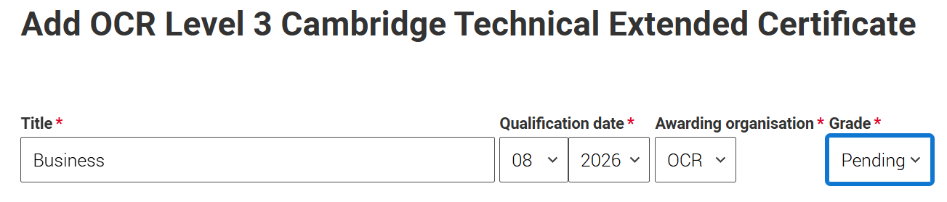
Education - Adding a Tech Voc. Course
Select ‘subject’ from the drop down list
Select qualification date as August 2026
Select Exam board
IMPORTANT!! – Select grade as ‘PENDING’
* Do not complete the individual module sections. Scroll to bottom and save.
Repeat to add your next college subject

Slide 11
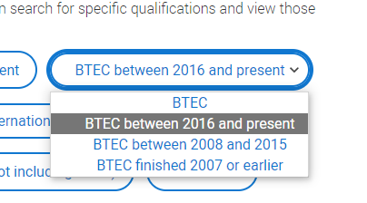
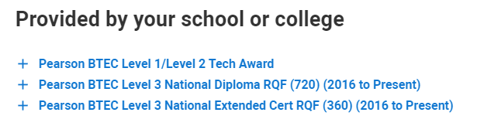
Education - Adding a BTEC Vocational Course
Add qualification
Choose from the qualifications list
Select BTEC : 2016 - Present
Double Award : Select Diploma (L3)
(Double Sport)
Single Award : Select Extended Certificate (L3) (Single Science, Single Sport,
Engineering, Travel & Tourism)

Slide 12
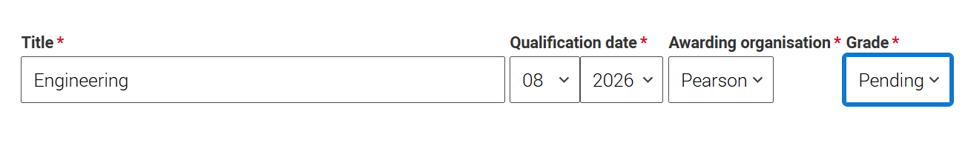
Education - Adding a BTEC Voc. Course
Select ‘subject’ from the drop down list
Select qualification date as August 2026
Select Exam board
IMPORTANT!! – Select grade as ‘PENDING’
* Do not complete the individual module sections. Scroll to bottom and save.
Repeat to add your next college subject

Slide 13
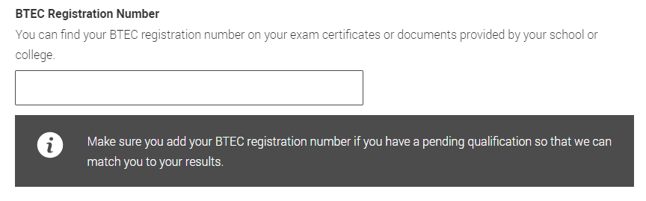
Education
BTEC Registration
  If you have added a BTEC qualification, then you will now have an additional section. This number can be obtained from Mr. Lawrence.
  It is only needed for Level 3 awards, otherwise leave blank.

Slide 14
Additional College Subjects

Slide 15
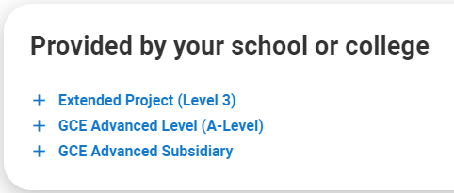
Education – Add EPQ if required
Choose from the qualifications list
Select A Level, AS and EPQ
Choose Extended Project (Level 3)

Slide 16
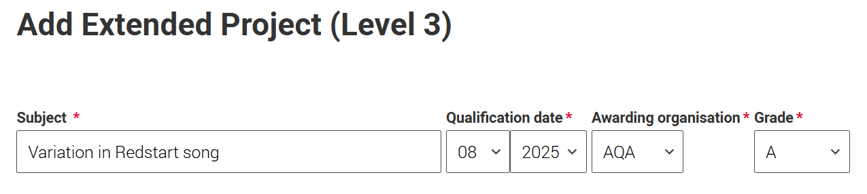
Education - Add EPQ if required
Subject – Add a SHORT title for your EPQ
Select qualification date as August 2025
Select Exam board (AQA)
IMPORTANT!! – Select grade that has been awarded
* This award should also be added as PENDING if you have not yet finished the award

Slide 17
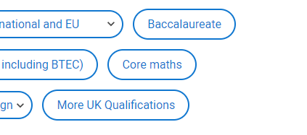
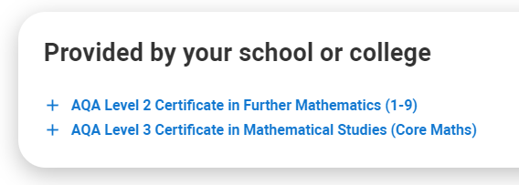
Education – Add Core Maths if required
Choose from the qualifications list
Select Core Maths
Choose Certificate in Mathematical Studies (Level 3)

Slide 18
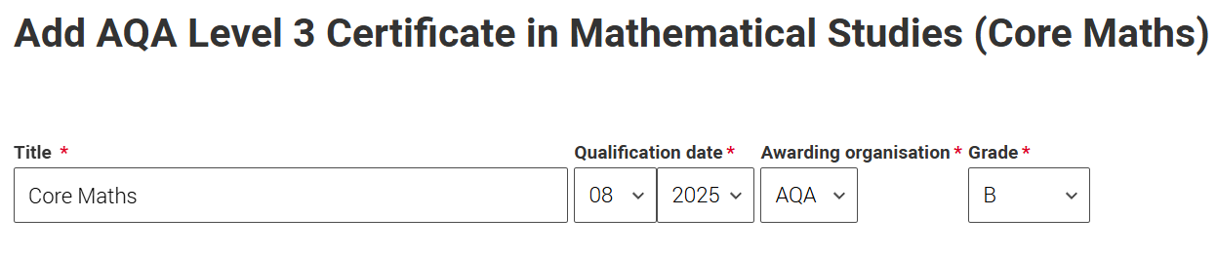
Education - Add Core Maths if required
Add title = Core Maths
Select qualification date as August 2025
Select Exam board = AQA
Add Grade

Slide 19
GCSE Qualifications

Slide 20
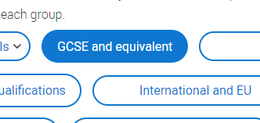
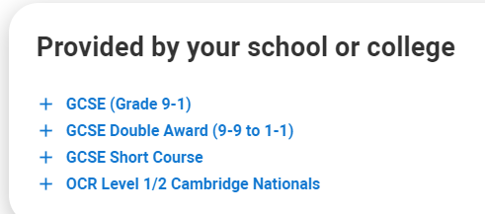
Education – Adding GCSE Results
Select Education > Add Qualification
Select ‘GCSE and equivalent’
GCSE (Grade 9-1) - Most your Yr11 results (including triple science)
GCSE : Double Award – Trilogy Science

Slide 21
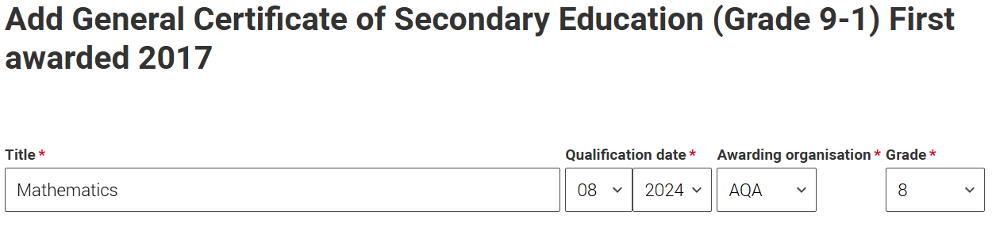
Education
Continue to select ‘subject’ from the drop down list
Select qualification date as August 2024
Select Exam board (Refer to your exam certificate )
Select grade that was awarded (Refer to your exam certificate )
* Accuracy is CRITICAL. Universities WILL ask for verification, so please ensure that your grades are correct and that your certificates are available.
* Do not complete the individual module sections. Scroll to bottom and save and add similar.

Slide 22
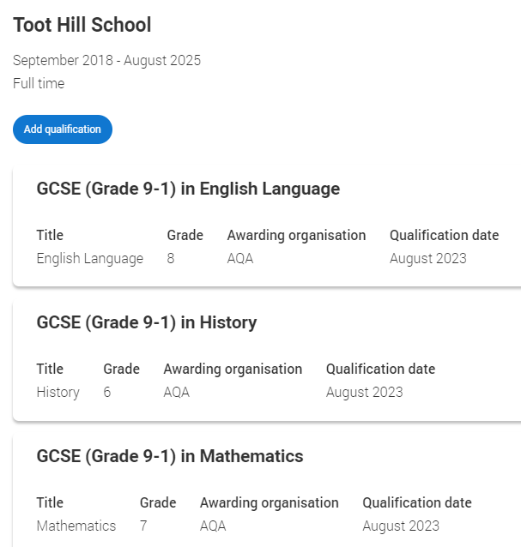
Education
Continue until you have added all your GCSE grades
You should be declaring between 8 – 10 awards
Further relevant assessments can be added using the add qualification > search tool i.e graded music awards (see later)
* Ensure that this section is saved. Do not mark as section complete UNTIL you have verified your awards

Slide 23
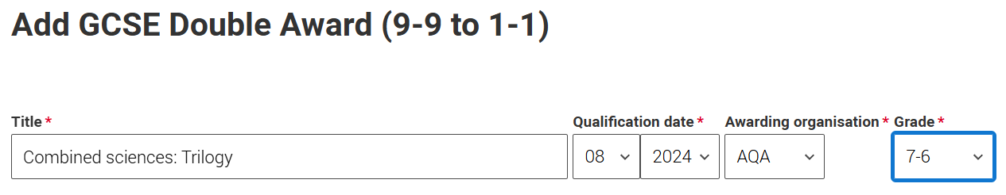
Education – Adding Double Award Science GCSE Results if required
Select ‘add qualifications’
Select from the ‘GCSE - Popular qualifications’ list
GCSE : Double Award – Combined Science : Trilogy
Date : 08/2024
Exam Board : AQA
Grade = ?-?

Slide 24
Education – Adding Further Maths (Yr11) if required
Select ‘add qualifications’
Select from the ‘Core Maths - Popular qualifications’ list
Select Level 2 Certificate in Further Maths
Date : 08/2024
Exam Board : AQA
Grade = ?

Slide 25
Education - Adding a BTEC (Level 1/2)
Add qualification
Choose from the qualifications list
Select BTEC : 2016 - Present
Choose BTEC Level 1/2 Tech Award
Courses include ENGINEERING, SPORT (Activity & Fitness) and DANCE

Slide 26
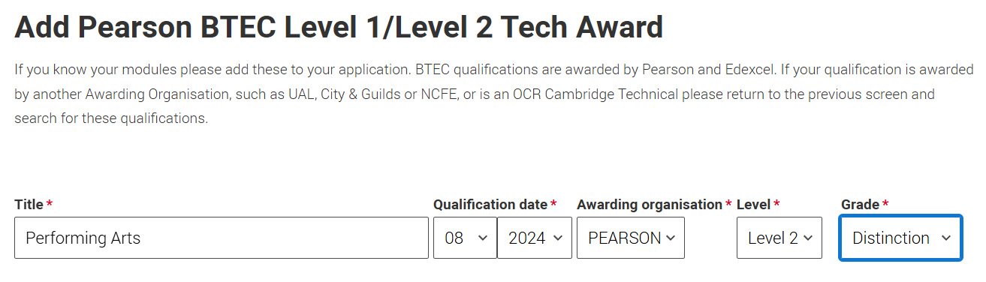
Education
Continue to select ‘subject’ from the drop down list. Type in title and select as appropriate
Select qualification date as August 2024
Select Exam board (Refer to your exam certificate )
Select Level 2
Select grade that was awarded (Refer to your exam certificate )
* Accuracy is CRITICAL. Universities WILL ask for verification, so please ensure that your grades are correct
* Do not complete the individual module sections. Scroll to bottom and save and add similar.

Slide 27
Education – Adding Cambridge National (CNAT)
Select Education > Add Qualification
Select ‘GCSE and equivalent’
OCR Level 1/2 Cambridge Nationals
Courses include Enterprise & Marketing, Sport, Creative iMedia

Slide 28
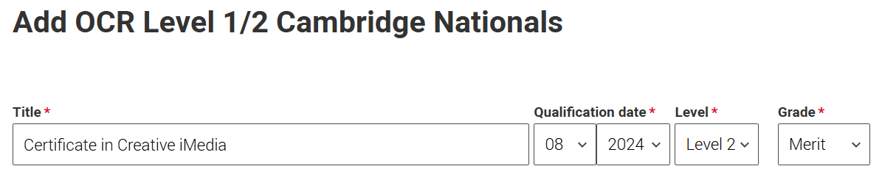
Education
Continue to select ‘subject’ from the drop down list. Type in your subject.
Select qualification date as August 2024
Select level 2
Select grade that was awarded (Refer to your exam certificate )
* Accuracy is CRITICAL. Universities WILL ask for verification, so please ensure that your grades are correct
* Do not complete the individual module sections. Scroll to bottom and save and add similar.

Slide 29
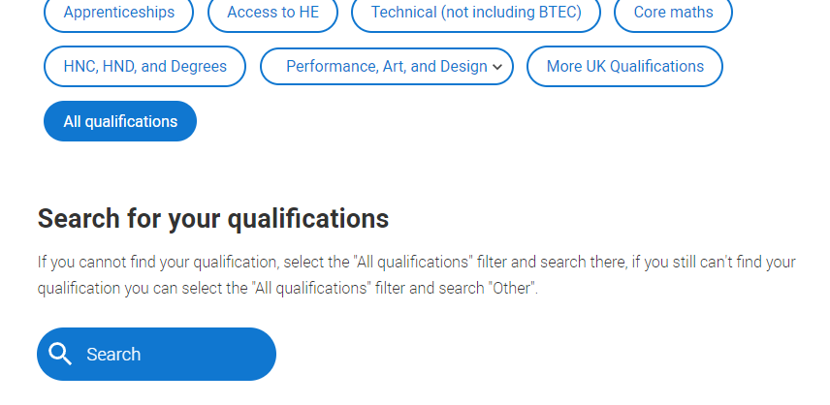
Education – Other Awards
You can search for other awards if required.
Select ‘All qualifications’
Use the search function to find the appropriate award that best matches your certification.
In year 11, you will have been completing Level 2 courses
Award date remains as August 2024 (unless specified)

Slide 30
Education - Completed

