Slide 1
UCAS 2026 Application
Right First Time

Slide 2
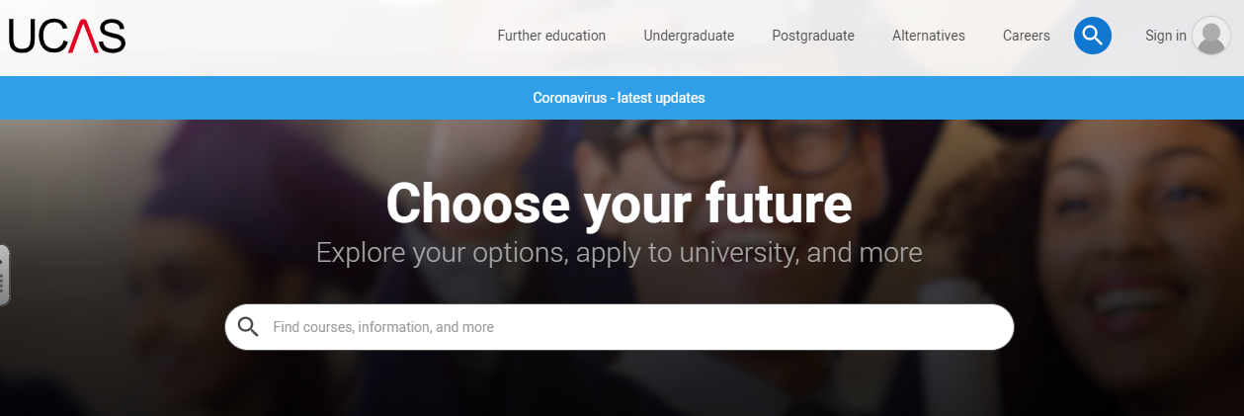
Register with UCAS 2026
To begin the application process for university, you will need to register an account and link this to our college.
The registration process is free and can be started today.
ALL Y12 students will be asked to register for 2026

Slide 3
Register with UCAS 2026
UCAS: - This is the centralised organisation that handles ALL applications for entry into higher education.
They act as a clearing house, processing all submissions from students and staff, forwarding applications to institutions and then dealing with the offers, acceptances and clearing processes that follow.
You MUST go through UCAS to make any higher education application.

Slide 4
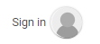

How to REGISTER with UCAS
1. Go to ucas.com
2. Click on icon Select Sign in > Students
3. Select Register

Slide 5
Proceed to REGISTER
Enter your email address
IMPORTANT : Use a personal email address that you are most likely to use on a regular basis. Please use a sensible account name. Remember that the universities will see and use this information.
Do not use your school account.
Enter First name (only) and Surname
Ensure that you correctly capitalise your name : e.g Matty Palmer
Complete the password. It is sensible to RECORD/SAVE your password at this point. College have no record and cannot change this for you.
Tick the box ‘Terms & Conditions’

Slide 6
Verify your Account
Go to your email address and find your code
Check your Junk if it is not in your Inbox
A surprising amount of emails from UCAS and your universities will initially land in your junk, so do check this regularly.
Copy this across and verify your account

Slide 7
Details
Select year of study – 2026
Select level of study – Undergraduate
Where do you live – Correct postcode for your home address
Select your preferences – Including preferred contact details. Ensure you enter your mobile number.
Select at least one subject that you wish to study at university. If unsure, enter your current subject/s.
Enter ‘ Toot Hill’ to the search – Select school
Select ‘Create Account’

