Slide 1
Login to UCAS : UCAS
Go to my Hub
Select ‘2026 Applications’
Start application

Slide 2
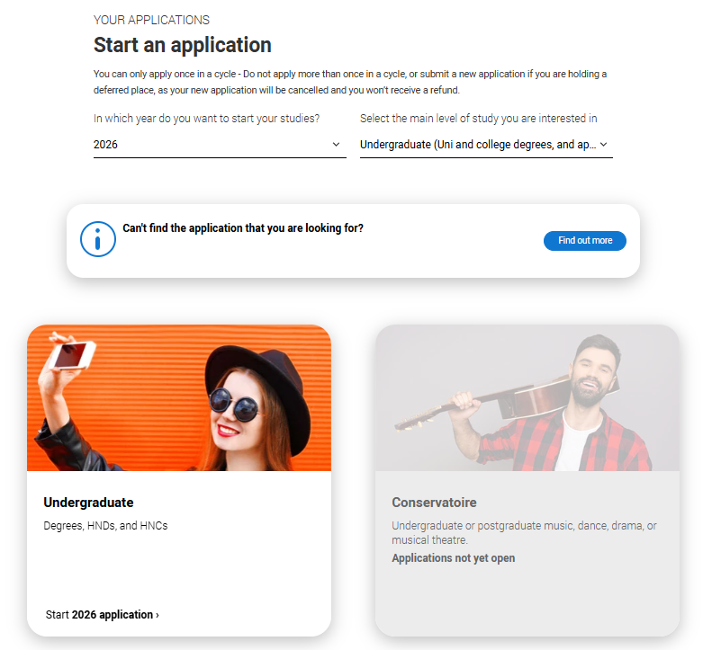
How to REGISTER with UCAS
!! 1. IMPORTANT - Select 2026 entry !!
2. Select Undergraduate

Slide 3
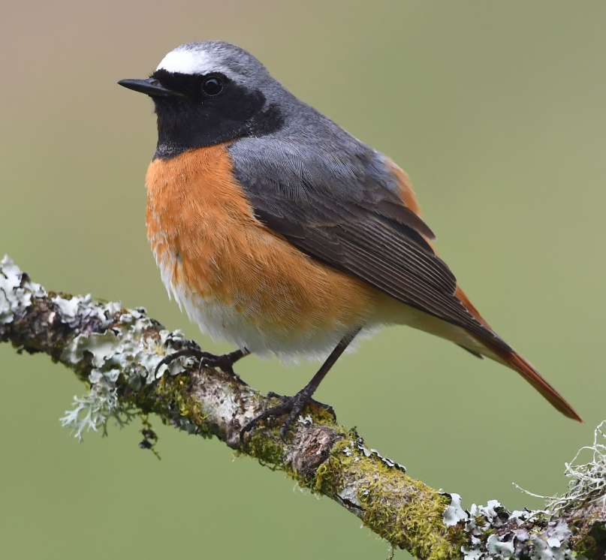
UCAS Hub
Select ‘Start New Application’
    Undergraduate
    Apply from school, college & centre = YES
    Enter the Buzzword = Redstart2026
    Select Tutor Group – 13. ??

Slide 4
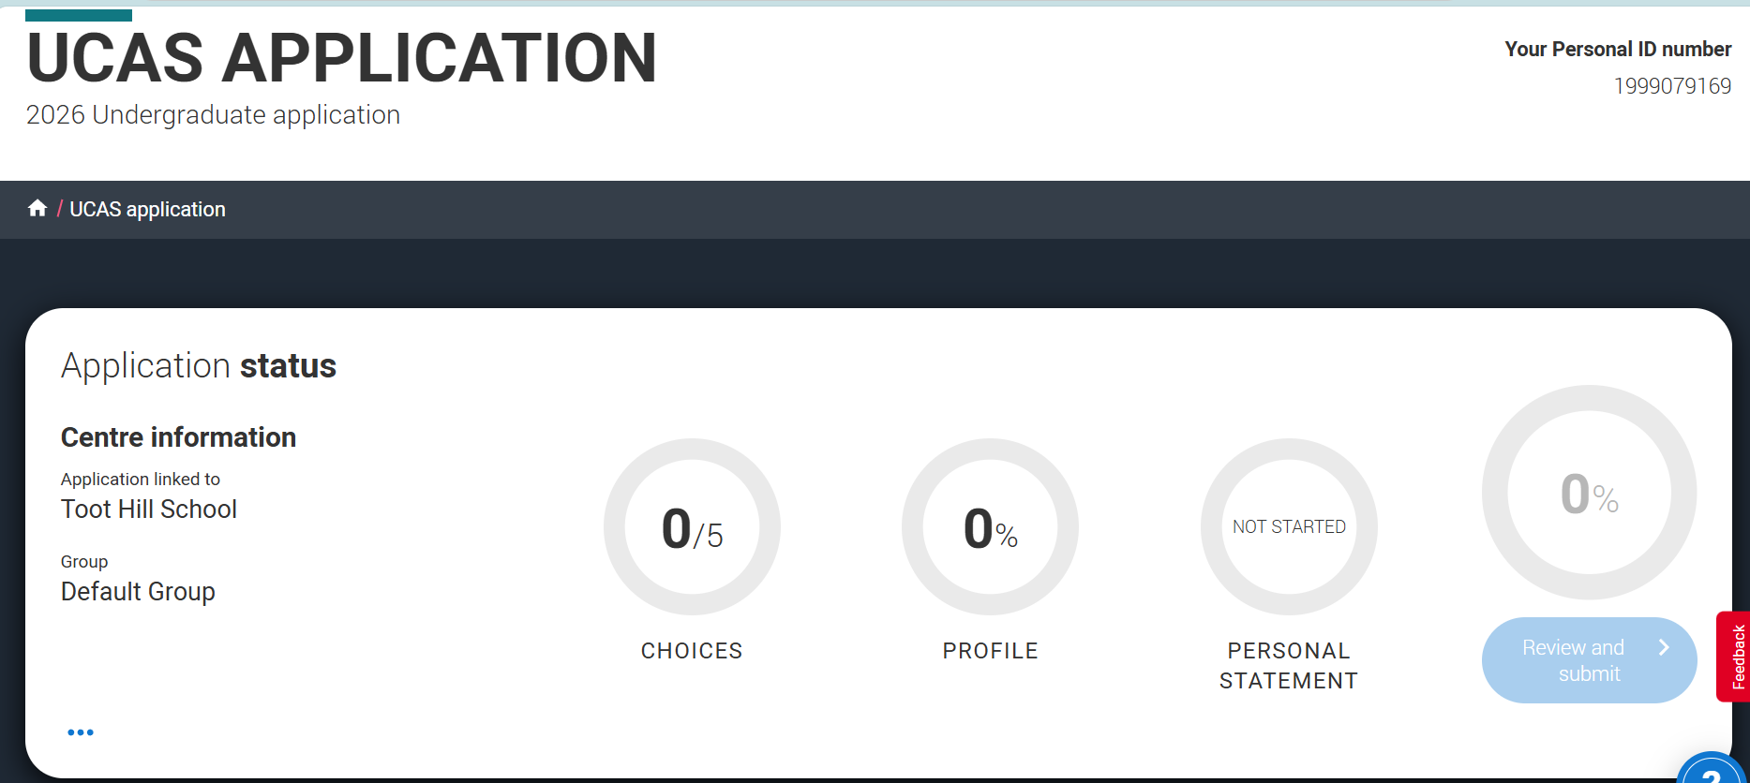
Application Details
Record your Personal ID Number
Your application is now ready to begin

Slide 5
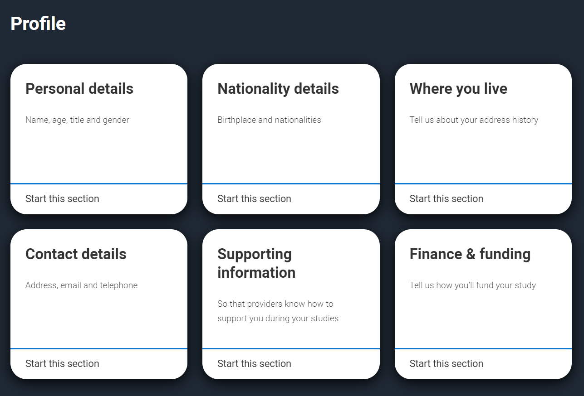
Application Details
3. Where you live
  Home address
  Residential category
  Save section
1. Select Personal Details
  Complete (including preferred name)
  Check as completed
  Save section
2. Nationality – Country of birth
Nationality & Dual National?
Save section

Slide 6
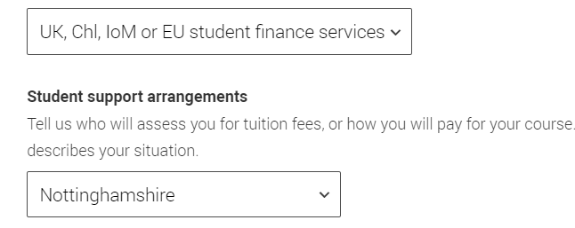
Application Details
5. Supporting
EU status
Save section
4. Contact Details
  Check personal email address
  Nominated access is optional. Do NOT select your mentor.
  Save section
6. Finance
  Select UK Student Finances services
  NottinghamSHIRE *
  *(or Leicestershire if Bottesford)
  Save section

Slide 7
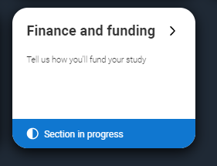
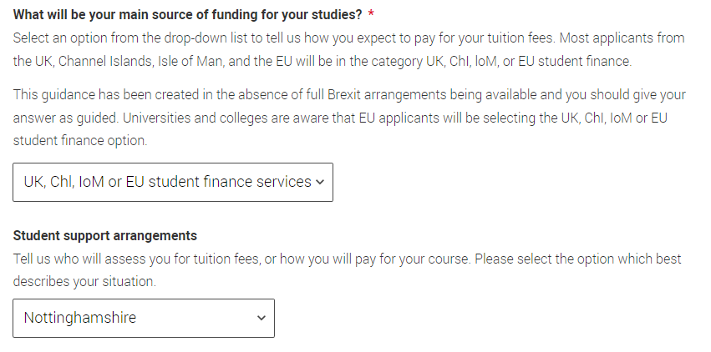
Please check this section. It is the most common error on applications
Select Finance and Funding
  Funding source : Select UK, ChI, IoM or EU Student Finance Services
  Please speak with Mr. Lawrence if you feel this should be different
  Student support arrangements : Select your Local Authority
  i.e NottinghamSHIRE
  *(or Leicestershire)

Slide 8
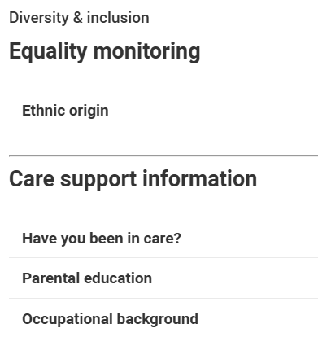
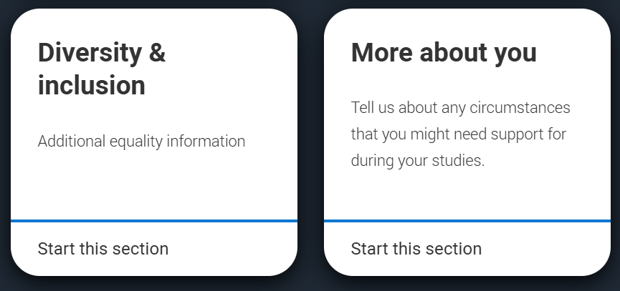
Application Details
7. Select Diversity & Inclusion
  Ethnicity
  Care status
  Parental Education
  Select NO if neither parent has a degree (or higher) level award. It is important to get this right.
  Occ. Background

Slide 9
Application Details
8. Select More about you
  This section includes more sensitive and personal information.
  It is treated confidentially and will be used to help contextualise your application.
  Please complete this section at a later date in private if you prefer.

Slide 10
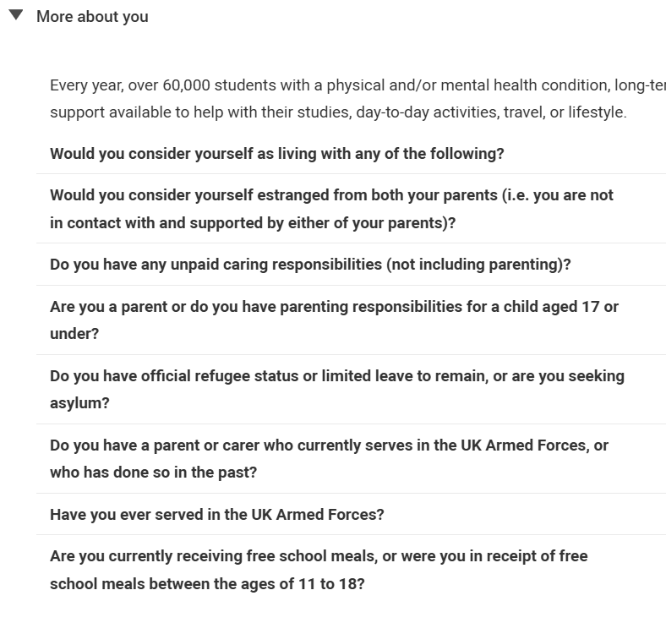
Application Details
8. Select More about you
  Complete, adding sensitive and confidential contextual information
  Save section
Check FSM status with Mr. Lawrence if applicable. * Eligible students do NOT pay the UCAS fee

Slide 11
Personal & Contact Details
Congratulations
You should now have successfully registered and completed the first section of your UCAS application (8 sections completed)
Further instruction and guidance will be given to complete the remaining sections

Slide 12
Coming soon : UCAS Education
You will need to ACCURATELY complete this section with the guidance of your mentor (in a future session)
Please take a photo of your gcse exam certificates and results. You will need to know EXACTLY what subject/exam board/level awarded for the completion of the education section.

Slide 13
UCAS Hub
Now use your new UCAS account to explore the Hub.
This allows you to better search for relevant courses and apprenticeship opportunities.
You can tailor your UCAS Hub account to match your specific interests and subject choices.

