Slide 1
TCAS
How to request a REFERENCE

Slide 2
Academic Reference
Subject teachers write a specific reference about your qualities in their subject area
College mentors collate and edit, carefully adding further information about your strengths and interests.
This reference is a critical part of your future application and will be used for UCAS, Apprenticeships and employment opportunities.

Slide 3
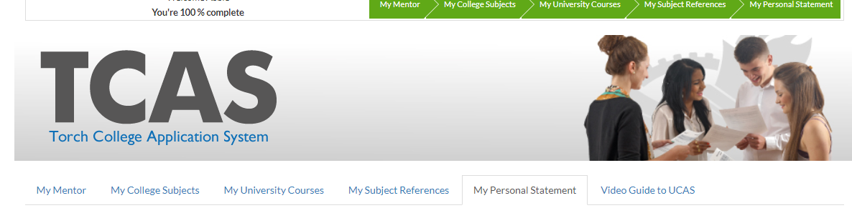
TCAS - Reference
Subject request through the TCAS app
Entirely INTERNAL and does not link to UCAS in any way
Allows students to request all subject references in one place

Slide 4
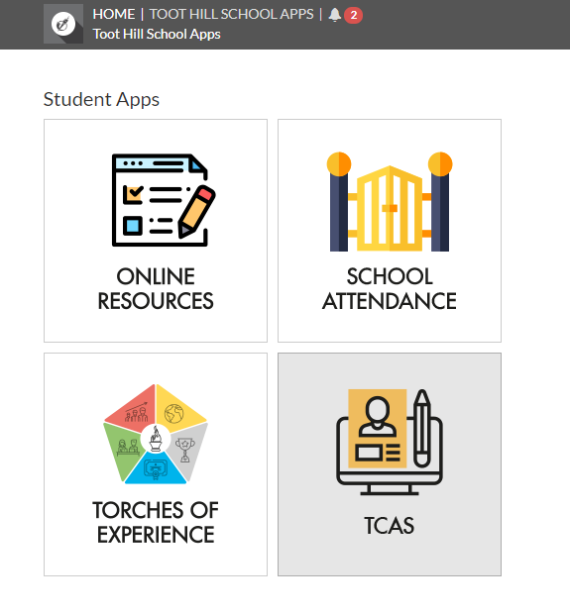
TCAS app
https://apps.toothillschool.co.uk/
Login using your school email address and password
Select TCAS app

Slide 5
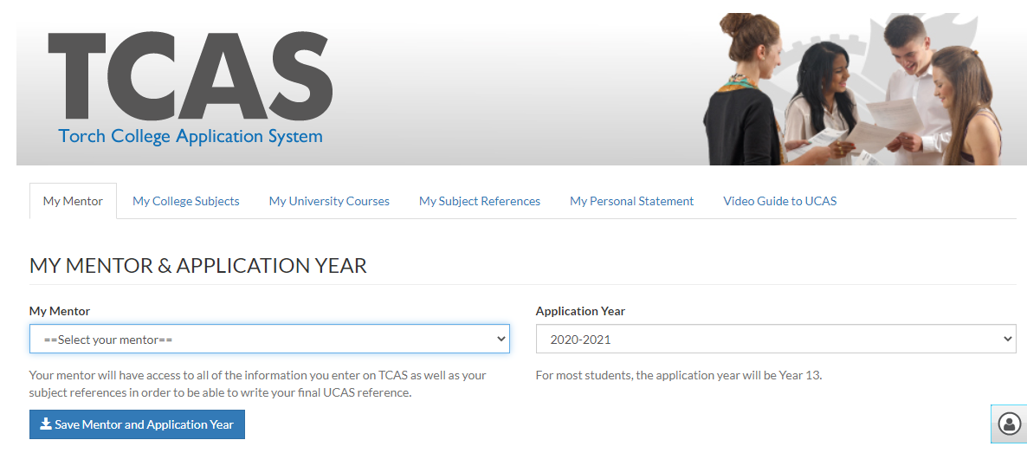
TCAS - Mentor
Select Tab – My Mentor
Choose correct college mentor from the drop down list
Select application year 2020-2021
Save using blue button

Slide 6
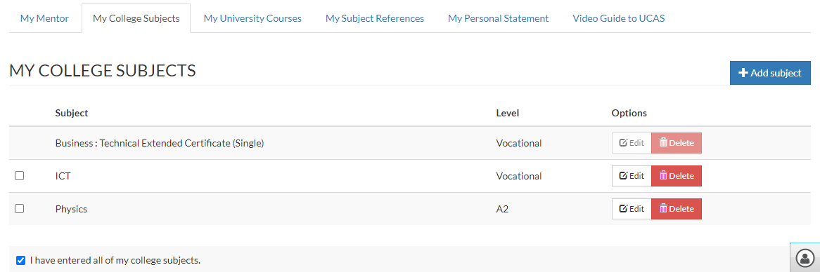
TCAS – My College Subjects
Select Tab – My College subjects
Click Add subject. Choose correct subjects from the drop down list. Check the box once completed.

Slide 7
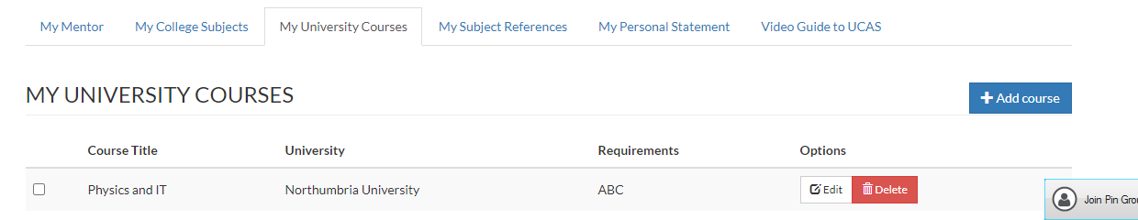
TCAS – My University Course
Select Tab – My University
Click Add course. Free text your preferred subjects, possible university and likely grade requirement. This does not have to be accurate and you can add more courses if you like. It gives an indication of what you are interested in doing next and will help inform your referees writing.

Slide 8
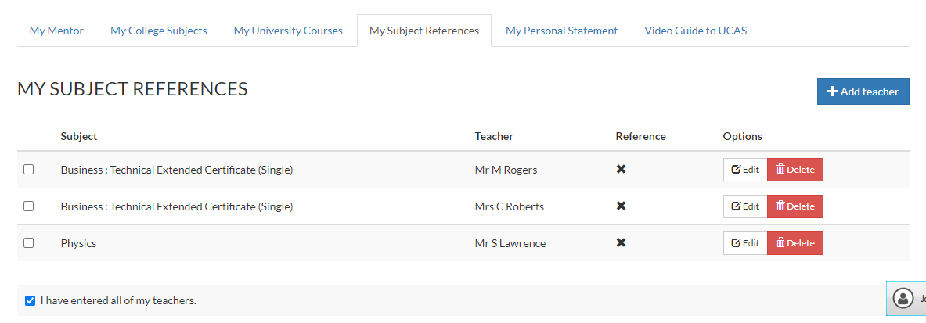
TCAS – My Subject References
Select Tab – My Subject References
Click Add teacher. Select subject and teacher from the drop down list. Select TWO of your timetabled teaching staff per subject. Once completed, check the box.

Slide 9
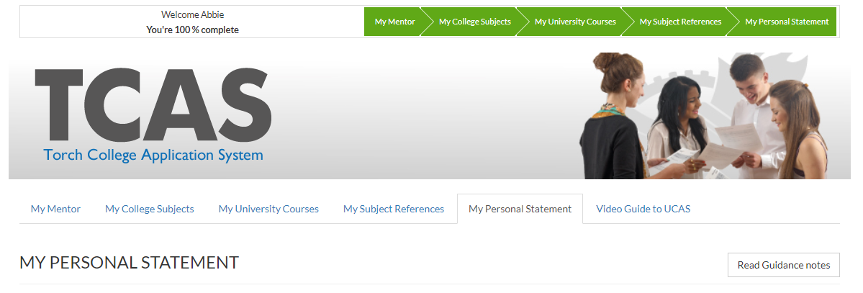
TCAS – My Personal Statement
IGNORE this Tab – All of our work on Personal Statements will now be completed using the Unifrog app.
Do not add anything to this tab EVER. It will remain hidden and unloved forever more…

Slide 10
TCAS - Completed
You have now successfully completed the reference request process.
Your selected subject teachers will now have been emailed an academic reference request on your behalf.
Please understand that this process will now take time to complete.
You can help your teachers/mentor by sharing with them your aspirations and ambitions for the future.

